Slide 1

:CAPSTONE PROJECT: EDA on Airbnb booking
By-
GULAM SARVAR

Slide 2
What is Airbnb?
Airbnb is a American based which host an online marketplace and hospitality service, for people to lease for rent short term lodging.
guests and hosts have used Airbnb to expand on traveling possibilities and present a more unique, personalized way of experiencing the world.

Slide 3
Problem Statement
Our main objective is to find out the key metrics that influence the listing of properties on the platform. For this, we will explore and visualize the dataset from Airbnb in NYC using basic exploratory data analysis (EDA) techniques.
Data analysis on thousands of listings provided through Airbnb is a crucial factor for the company.
We will be finding out the distribution of every Airbnb listing based on their location, including their price range, room type, listing name, and other related factors.

Slide 4
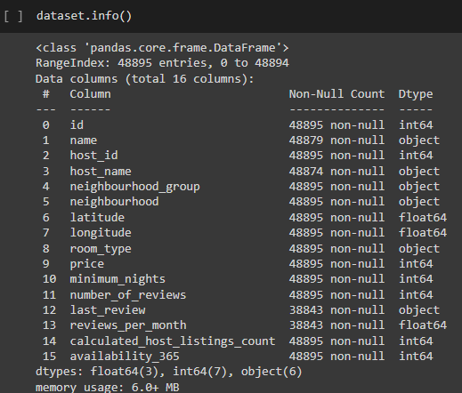
Understanding the Data
This dataset has around 49,000 observations in it with 16 columns and it is a mix between categorical and numeric values.
for detail overview of data, we upload it in google colab
As we in this screenshot there is 16 column with different entries

Slide 5
Explore and analyze the data to discover key understandings such as :
What can we learn about different hosts and areas?
What can we learn from predictions? (ex: locations, prices, reviews, etc.)
Which hosts are the busiest and why?
Is there any noticeable difference of traffic among different areas and what could be the reason for it?

Slide 6
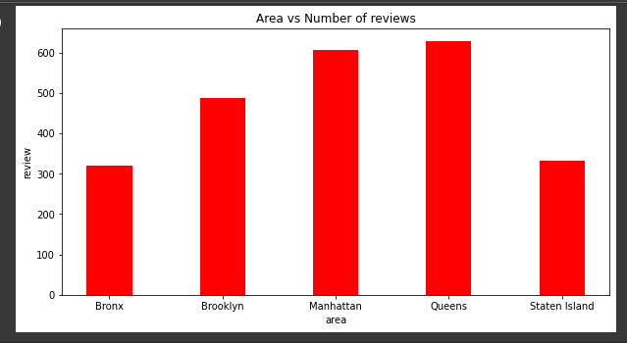
What can we learn about areas?
from this plot we clearly see that Queens and Manhattan have maximum number of review by the visitor that means the most traffic location is queens and Manhattan

Slide 7
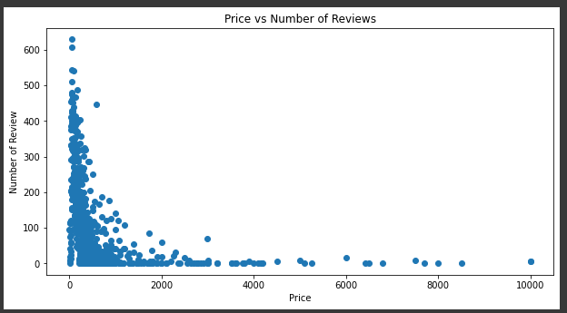
What can we learn about areas?
from the above plot we can clearly see that people stay in hotel with highest rating with cheap price.

Slide 8
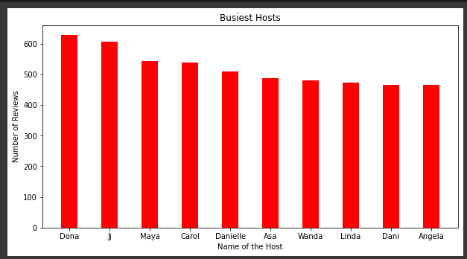
Which hosts are the busiest ?
Busiest hosts are:
Dona
Ji
Maya
Carol
Danielle Because these hosts listed room type as Entire home and Private room which is preferred by most number of people

Slide 9
Conclusion:
From the Above Analysis We can Stay that People are preferring Entire home/apt or Private room which are present in Manhattan, Brooklyn, Queens and people are preferring listings which are less in price.

Slide 10
thank you
GULAM SARVAR

